Slide 1
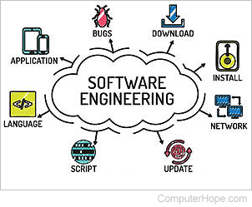
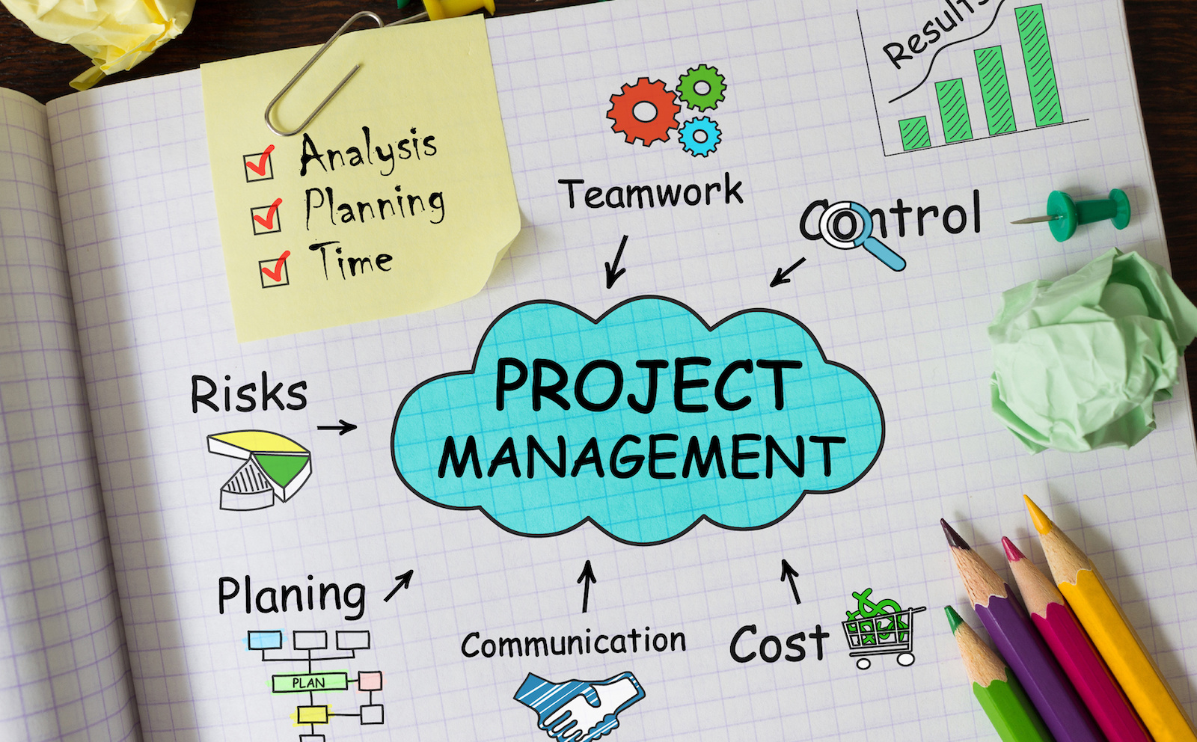
SOFTWARE ENGINEERING & PROJECT MANAGEMENT(21CS61)

Slide 2
Course Objectives
2
CLO 1. Outline software engineering principles and activities involved in building large software programs. Identify ethical and professional issues and explain why they are of concern to Software Engineers.
CLO 2. Describe the process of requirement gathering, requirement classification, requirement specification and requirements validation.
CLO 3. Infer the fundamentals of object oriented concepts, differentiate system models, use UML diagrams and apply design patterns.
CLO 4. Explain the role of DevOps in Agile Implementation.
CLO 5. Discuss various types of software testing practices and software evolution processes.
CLO 6. Recognize the importance Project Management with its methods and methodologies.
CLO 7. Identify software quality parameters and quantify software using measurements and metrics. List software quality standards and outline the practices involved

Slide 3
Course Outcomes
3
Course Outcomes
By the end of this course, students will be able to
CO1 - Understand the activities involved in software engineering and analyze the role of various process models
CO2- Explain the basics of object-oriented concepts and build a suitable class model using modelling techniques
CO3 - Describe various software testing methods and to understand the importance of agile methodology and DevOps
CO4 - Illustrate the role of project planning and quality management in software development.
CO5 - Understand the importance of activity planning and different planning models

Slide 4
Modules
4
Module – 1
Software and Software Engineering: The nature of Software, The unique nature of WebApps, Software Engineering, The software Process, The software Engineering practice, The software myths, How it all starts.
Process Models: A generic process model, Process assessment and improvement, Prescriptive process models, Waterfall model, Incremental process models, Evolutionary process models, Concurrent models, Specialized process models.
Module –2
Understanding Requirements: Requirements Engineering, Establishing the ground work, Eliciting Requirements, Developing use cases, Building the requirements model, Negotiating Requirements, Validating Requirements
Requirements Modeling Scenarios, Information and Analysis classes: Requirement Analysis, Scenario based modeling, UML models that supplement the Use Case, Data modeling Concepts class Based Modeling.

Slide 5
5
Module – 3:
AGILE DEVELOPMENT: What is Agility?, Agility and the cost of change. What is an agile Process?, Extreme P programming (XP), Other Agile Process Models, A tool set for Agile process Principles that guide practice: Software Engineering Knowledge, Core principles, Principles that guide each framework activity
Module – 4:
Introduction to Project Management: Introduction, Project and Importance of Project Management, Contract Management, Activities Covered by Software Project Management, Plans, Methods and Methodologies, Some ways of categorizing Software Projects, Stakeholders, Setting Objectives, Business Case, Project Success and Failure, Management and Management Control, Project Management life cycle, Traditional versus Modern Project Management Practices
Module – 5:
Software Quality: Introduction, The place of software quality in project planning, Importance of software quality, Defining software quality, quality models, ISO 9126, product and process metrics, product versus process quality management, Quality Management systems, process capability models, techniques to enhance software quality, testing, Software reliability, quality plans
*

Slide 6
Text books and Reference books
6
Roger S. Pressman: Software Engineering-A Practitioners approach, 7th Edition, Tata McGraw Hill.
Rob Hughes, Mike Cotterell, Rajib Mall: Software Project Management, 6th Edition, McGraw Hill Education, 2018.
Reference:
1. Pankaj Jalote: An Integrated Approach to Software Engineering, Wiley India.

Slide 7
SE&PM - Module 1
Module – 1
Software and Software Engineering: The nature of Software The unique nature of WebApps, Software Engineering, The software Process, The software Engineering practice, The software myths, How it all starts.
Process Models: A generic process model, Process assessment and improvement, Prescriptive process models, Waterfall model, Incremental process models, Evolutionary process models, Concurrent models, Specialized process models.

Slide 8
Nature of Software
Software is:
Instructions (computer programs) that to executed provide desired features, function, and performance.
Data structures that enable the programs to adequately manipulate information, and
Document that describes the operation and use of the programs.
Characteristics of software:
Reliability: The ability of the software to consistently perform its intended tasks without unexpected failures or errors.
Usability: How easily and effectively users can interact with and navigate through the software.
Efficiency: The optimal utilization of system resources to perform tasks on time.
Maintainability: How easily and cost-effectively software can be modified, updated, or extended.
Portability: The ability of software to run on different platforms or environments without requiring significant modifications.

Slide 9
Changing Nature of Software
System Software: System software is a collection of programs that are written to service other programs.
Application Software: Application software is defined as programs that solve a specific business need.
Engineering and Scientific Software: This software is used to facilitate the engineering function and task. however modern applications within the engineering and scientific area are moving away from conventional numerical algorithms. Computer-aided design, system simulation, and other interactive applications have begun to take a real-time and even system software characteristic.

Slide 10
Changing Nature of Software
Embedded Software: Embedded software resides within the system or product and is used to implement and control features and functions for the end-user and for the system itself.
5. Web Application: It is a client-server computer program that the client runs on the web browser. In their simplest form, Web apps can be little more than a set of linked hypertext files that present information using text and limited graphics.
6. Artificial Intelligence Software: Artificial intelligence software makes use of a nonnumerical algorithm to solve a complex problem that is not amenable to computation or straightforward analysis. Applications within this area include robotics, expert systems, pattern recognition, artificial neural networks, theorem proving, and game playing.

Slide 11
What is Software Engineering?
Software + Engineering
The software is a collection of integrated programs.
Software subsists of carefully-organized instructions and code written by developers on any of various particular computer languages.
Computer programs and related documentation such as requirements, design models and user manuals.
Engineering is the application of scientific and practical knowledge to invent, design, build, maintain, and improve frameworks, processes, etc.

Slide 12
What is Software Engineering? [Contd..]
Software Engineering is an engineering approach for software development.
Software Engineering provides tools and techniques which can be used to design and develop a software in a systematic and cost effective manner.
Software Engineering is an engineering branch related to the evolution of software product using well-defined scientific principles, techniques, and procedures.
The result of software engineering is an effective and reliable software product.
5

Slide 13
Why is Software Engineering required?
To manage Large software
For more Scalability
Cost Management
To manage the dynamic nature of software
For better quality Management

Slide 14
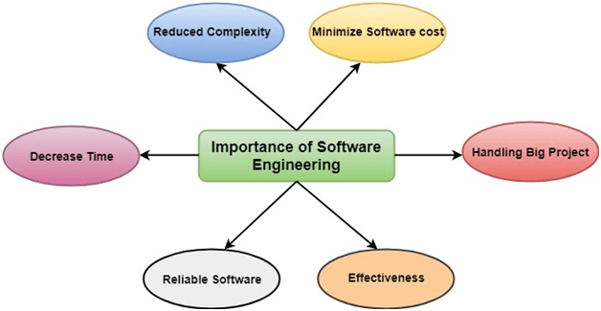

Slide 15
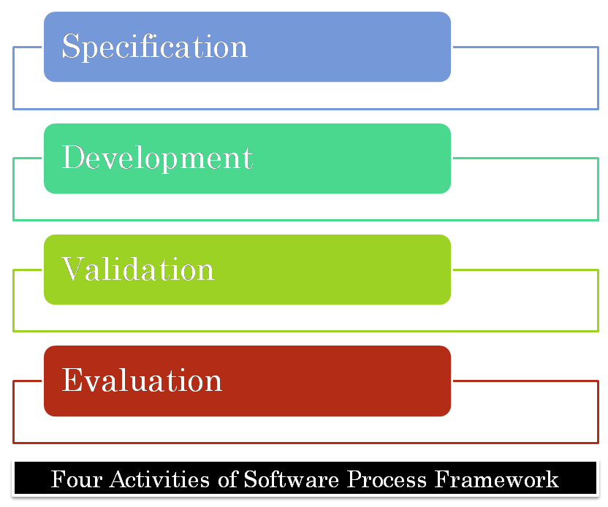
Software Process
The term software specifies to the set of computer programs, procedures and associated documents (Flowcharts, manuals, etc.) that describe the program and how they are to be used.
A software process is the set of activities and associated outcome that produce a software product.
Software engineers mostly carry out these activities.

Slide 16
Software process activities
Software specification, where customers and engineers define the software that is to be produced and the constraints on its operation.
Software development, where the software is designed and programmed.
Software validation, where the software is checked to ensure that it is what the customer requires.
Software evaluation, where the software is modified to reflect changing customer and market requirements.

Slide 17
The Software Process Model
A workflow model: This shows the series of activities in the process along with their inputs, outputs and dependencies. The activities in this model perform human actions.
A dataflow or activity model: This represents the process as a set of activities, each of which carries out some data transformations.
It shows how the input to the process, such as a specification is converted to an output such as a design.
A role/action model: This means the roles of the people involved in the software process and the activities for which they are responsible.

Slide 18
Software Crisis
Size: Software is becoming more expensive and more complex with the growing complexity and expectation out of software. For example, the code in the consumer product is doubling every couple of years.
Quality: Many software products have poor quality, i.e., the software products defects after putting into use due to ineffective testing technique. For example, Software testing typically finds 25 errors per 1000 lines of code.
Cost: Software development is costly i.e. in terms of time taken to develop and the money involved. For example, Development of the Advanced Automation System cost over $700 per lines of code.
Delayed Delivery: Serious schedule overruns are common. Very often the software takes longer than the estimated time to develop, which in turn leads to cost shooting up. For example, one in four large-scale development projects is never completed.

Slide 19
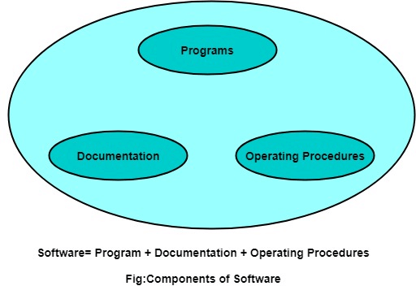
Program vs. Software
Software is more than programs. Any program is a subset of software, and it becomes software only if documentation & operating procedures manuals are prepared.
There are three components of the software as shown in fig:

Slide 20
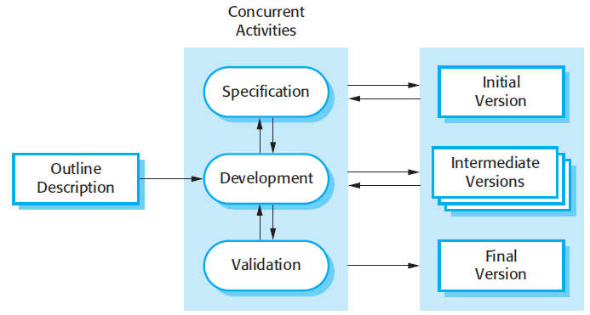

Slide 21
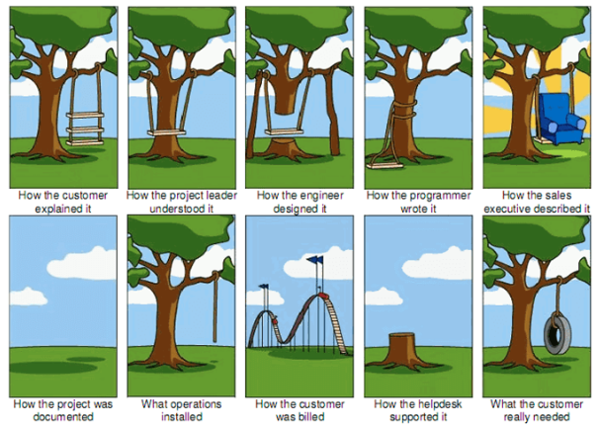

Slide 22
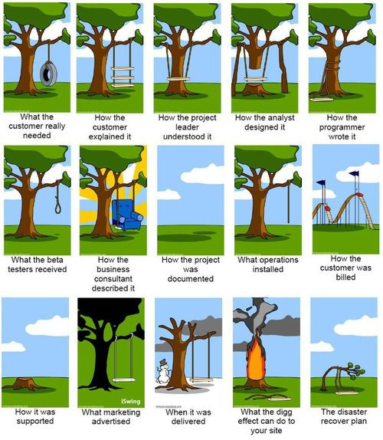

Slide 23
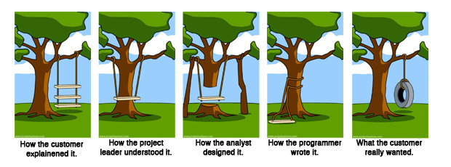

Slide 24
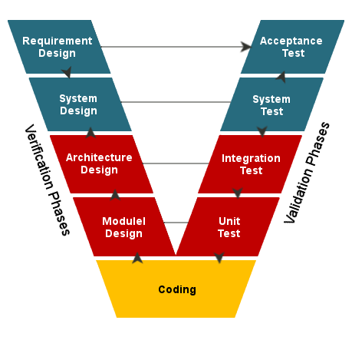
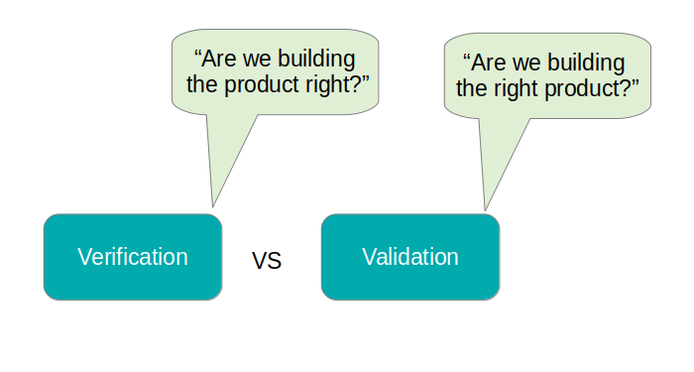
Verification vs Validation

Slide 25
Software Engineering Ethics

Slide 26
Software Engineering Ethics
Software engineering involves wider responsibilities than simply the application of technical skills.
Software engineers must behave in an honest and ethically responsible way if they are to be respected as professionals.
Ethical behaviour is more than simply upholding the law but involves following a set of principles that are morally correct.

Slide 27
Issues of professional responsibility
Confidentiality
Engineers should normally respect the confidentiality of their employers or clients irrespective of whether or not a formal confidentiality agreement has been signed.
Competence
Engineers should not misrepresent their level of competence. They should not knowingly accept work which is out with their competence.
Intellectual property rights
Engineers should be aware of local laws governing the use of intellectual property such as patents, copyright, etc. They should be careful to ensure that the intellectual property of employers and clients is protected.
Computer misuse
Software engineers should not use their technical skills to misuse other people’s computers. Computer misuse ranges from relatively trivial (game playing on an employer’s machine, say) to extremely serious (dissemination of viruses).

Slide 28
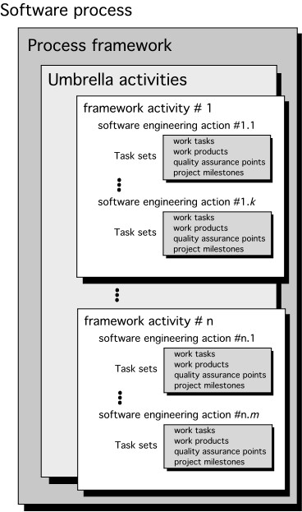
A Generic Process Model

Slide 29
Process Flow
• Process Flow shows how the framework activities and the actions and the tasks that occur within each activity are organized with respect to sequence and time.
Types of process flows in SDLC
1. Linear Process Flow
2. Iterative Process Flow
3. Evolutionary Process Flow
4. Parallel Process Flow

Slide 30
Linear Process Flow
A linear process flow executes each of the five framework
activities in sequence, beginning
with
communication
and
culminating with
deployment.
Linear Process Flow
Communication
Planning
Modeling
Construction
Deployment

Slide 31
Iterative Process Flow
An iterative process flow repeats one or more of the activities before proceeding to the next.
Communication
Planning
Modeling
Construction
Deployment

Slide 32
Evolutionary Process Flow
An evolutionary process
“circular” manner.
flow executes
the
activities
in
a
Communication
Planning
Modeling
Deployment
Construction

Slide 33
Parallel Process Flow
A parallel process flow executes
one or more
activities
in
parallel with other
activities.
Communication
Planning
Modeling
Time
Construction
Deployment

Slide 34
Process Assessment and Improvement
Software Process Assessment is a disciplined and organized examination of the software process which is being used by any organization bases the on the process model.
The Software Process Assessment includes many fields and parts like identification and characterization of current practices, the ability of current practices to control or avoid significant causes of poor (software) quality, cost, schedule and identifying areas of strengths and weaknesses of the software.
A software assessment (or audit) can be of three types –
A self-assessment (first-party assessment) is performed internally by an organization's own personnel.
A second-party assessment is performed by an external assessment team or the organization is assessed by a customer.
A third-party assessment is performed by an external party or (e.g., a supplier being assessed by a third party to verify its ability to enter contracts with a customer).

Slide 35
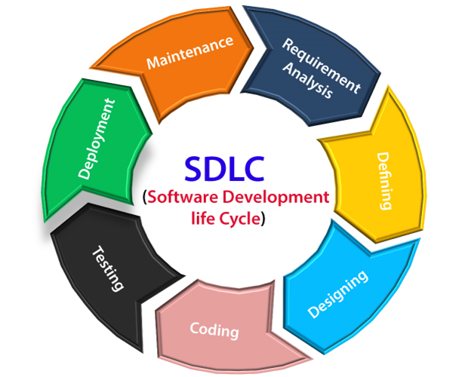
Software Development Life Cycle (SDLC)

Slide 36
Stage1: Planning and requirement analysis
Requirement Analysis is the most important and necessary stage in SDLC.
Stage2: Defining Requirements
Once the requirement analysis is done, the next stage is to certainly represent and document the software requirements and get them accepted from the project stakeholders.
This is accomplished through "SRS"- Software Requirement Specification document which contains all the product requirements to be constructed and developed during the project life cycle.
Stage3: Designing the Software
The next phase is about to bring down all the knowledge of requirements, analysis, and design of the software project.
This phase is the product of the last two, like inputs from the customer and requirement gathering.
Stage4: Developing the project
In this phase of SDLC, the actual development begins, and the programming is built.
The implementation of design begins concerning writing code.
Developers have to follow the coding guidelines described by their management and programming tools like compilers, interpreters, debuggers, etc. are used to develop and implement the code.

Slide 37
Stage5: Testing
After the code is generated, it is tested against the requirements to make sure that the products are solving the needs addressed and gathered during the requirements stage.
During this stage, unit testing, integration testing, system testing, acceptance testing are done.
Stage6: Deployment
Once the software is certified, and no bugs or errors are stated, then it is deployed.
Then based on the assessment, the software may be released as it is or with suggested enhancement in the object segment.
Stage7: Maintenance
Once when the client starts using the developed systems, then the real issues come up and requirements to be solved from time to time.
This procedure where the care is taken for the developed product is known as maintenance.

Slide 38
SDLC Models
Software Development life cycle (SDLC) is a spiritual model used in project management that defines the stages include in an information system development project, from an initial feasibility study to the maintenance of the completed application.
There are different software development life cycle models specify and design, which are followed during the software development phase.
These models are also called "Software Development Process Models."
Each process model follows a series of phase unique to its type to ensure success in the step of software development.

Slide 39
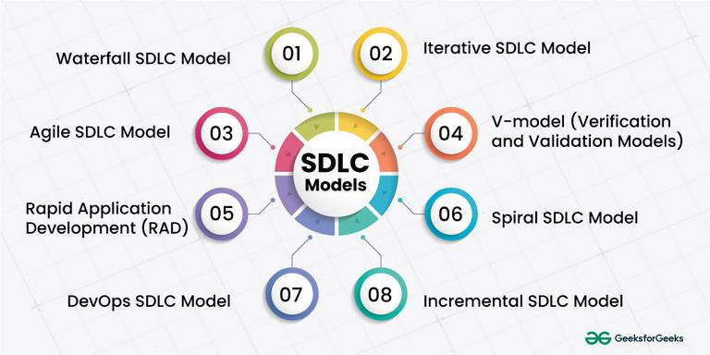

Slide 40
Requirement Engineering
Requirements engineering (RE) refers to the process of defining, documenting, and maintaining requirements in the engineering design process.
Requirement engineering provides the appropriate mechanism to understand what the customer desires, analyzing the need, and assessing feasibility, negotiating a reasonable solution, specifying the solution clearly, validating the specifications and managing the requirements as they are transformed into a working system.
Thus, requirement engineering is the disciplined application of proven principles, methods, tools, and notation to describe a proposed system's intended behavior and its associated constraints.

Slide 41
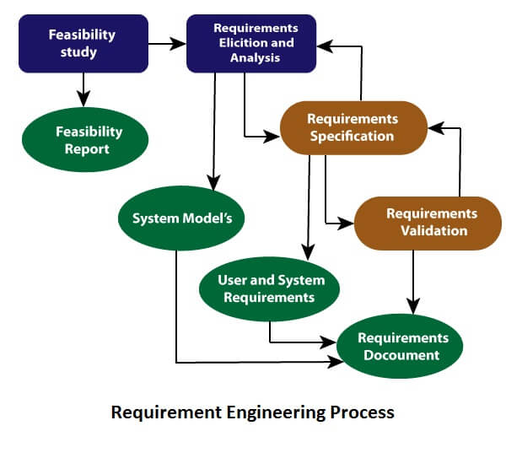
Requirement Engineering Process
It is a four-step process, which includes –
Feasibility Study
Requirement Elicitation and Analysis
Software Requirement Specification
Software Requirement Validation

Slide 42
Software Requirements
Functional Requirements:
Functional requirements define a function that a system or system element must be qualified to perform and must be documented in different forms.
The functional requirements are describing the behavior of the system as it correlates to the system's functionality.
Non-functional Requirements:
This can be the necessities that specify the criteria that can be used to decide the operation instead of specific behaviors of the system.
Non-functional requirements are divided into two main categories:
Execution qualities like security and usability, which are observable at run time.
Evolution qualities like testability, maintainability, extensibility, and scalability that embodied in the static structure of the software system.

Slide 44
Waterfall model
Winston R introduced the Waterfall Model in 1970.
This model has five phases: Requirements analysis and specification, design, implementation, and unit testing, integration and system testing, and operation and maintenance.
The steps always follow in this order and do not overlap.
The developer must complete every phase before the next phase begins.
This model is named "Waterfall Model", because its diagrammatic representation resembles a cascade of waterfalls.

Slide 45
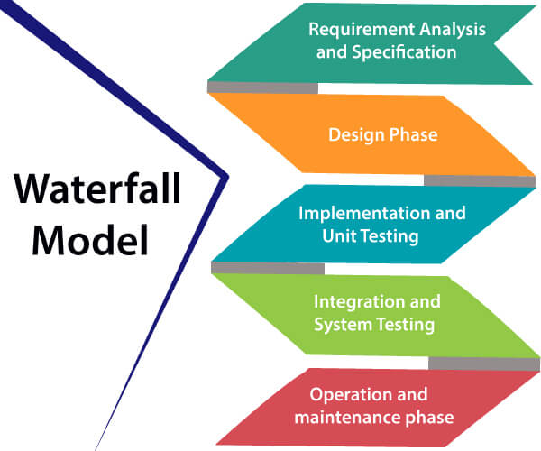
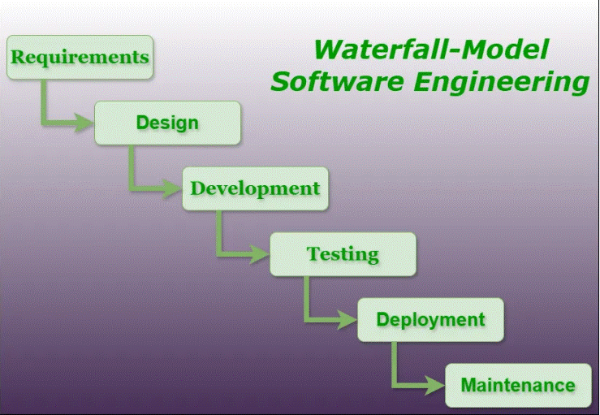

Slide 46
Waterfall model
Requirements analysis and specification phase:
The aim of this phase is to understand the exact requirements of the customer and to document them properly.
Both the customer and the software developer work together so as to document all the functions, performance, and interfacing requirement of the software.
It describes the "what" of the system to be produced and not "how.“
In this phase, a large document called Software Requirement Specification (SRS) document is created which contained a detailed description of what the system will do in the common language.

Slide 47
Waterfall model
2. Design Phase:
This phase aims to transform the requirements gathered in the SRS into a suitable form which permits further coding in a programming language.
It defines the overall software architecture together with high level and detailed design.
All this work is documented as a Software Design Document (SDD).
3. Implementation and unit testing:
During this phase, design is implemented.
If the SDD is complete, the implementation or coding phase proceeds smoothly, because all the information needed by software developers is contained in the SDD.
During testing, the code is thoroughly examined and modified.
Small modules are tested in isolation initially. After that these modules are tested by writing some overhead code to check the interaction between these modules and the flow of intermediate output.

Slide 48
Waterfall model
4. Integration and System Testing:
This phase is highly crucial as the quality of the end product is determined by the effectiveness of the testing carried out.
The better output will lead to satisfied customers, lower maintenance costs, and accurate results.
Unit testing determines the efficiency of individual modules.
However, in this phase, the modules are tested for their interactions with each other and with the system.
5. Operation and maintenance phase:
Maintenance is the task performed by every user once the software has been delivered to the customer, installed, and operational.

Slide 49
When to use SDLC Waterfall Model?
When the requirements are constant and not changed regularly.
A project is short
The situation is calm
Where the tools and technology used is consistent and is not changing
When resources are well prepared and are available to use.

Slide 50
Advantages of Waterfall model
This model is simple to implement also the number of resources that are required for it is minimal.
The requirements are simple and explicitly declared; they remain unchanged during the entire project development.
The start and end points for each phase is fixed, which makes it easy to cover progress.
The release date for the complete product, as well as its final cost, can be determined before development.
It gives easy to control and clarity for the customer due to a strict reporting system.

Slide 51
Disadvantages of Waterfall model
In this model, the risk factor is higher, so this model is not suitable for more significant and complex projects.
This model cannot accept the changes in requirements during development.
It becomes tough to go back to the phase. For example, if the application has now shifted to the coding phase, and there is a change in requirement, It becomes tough to go back and change it.
Since the testing done at a later stage, it does not allow identifying the challenges and risks in the earlier phase, so the risk reduction strategy is difficult to prepare.

Slide 52
Evolutionary Process Models
The evolutionary model is based on the concept of making an initial product and then evolving the software product over time with iterative and incremental approaches with proper feedback.
In this type of model, the product will go through several iterations and come up when the final product is built through multiple iterations.
Types of Evolutionary Process Models
Incremental Model
Iterative Model
Spiral Model

Slide 53
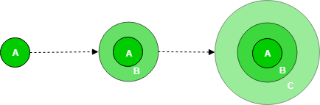
Incremental Process Model
Incremental Model is a process of software development where requirements divided into multiple standalone modules of the software development cycle.
In this model, each module goes through the requirements, design, implementation and testing phases.
Every subsequent release of the module adds function to the previous release. The process continues until the complete system achieved.
A, B, and C are modules of Software Products that are incrementally developed and delivered.

Slide 54
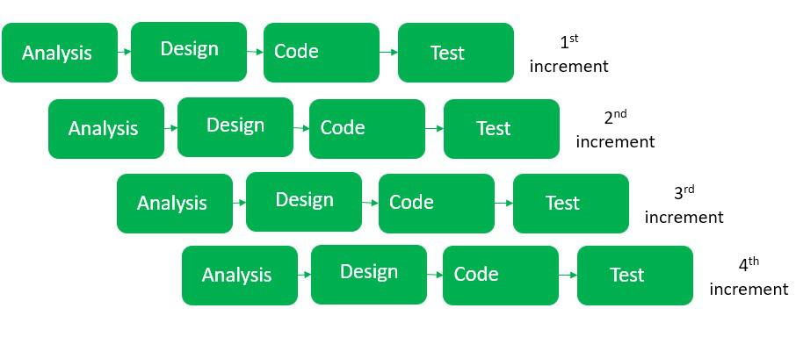

Slide 55
The various phases of incremental model
1. Requirement analysis: System functional requirements are understood by the requirement analysis team. To develop the software under the incremental model, this phase performs a crucial role.
2. Design & Development: Design of the system functionality and the development method are finished with success. When software develops new practicality, the incremental model uses style and development phase.
3. Testing: The testing phase checks the performance of each existing function as well as additional functionality. In the testing phase, the various methods are used to test the behavior of each task.
4. Implementation: Implementation phase enables the coding phase of the development system. It involves the final coding that design in the designing and development phase and tests the functionality in the testing phase. After completion of this phase, the number of the product working is enhanced and upgraded up to the final system product

Slide 56
When we use the Incremental Model?
When the requirements are superior.
A project has a lengthy development schedule.
When Software team are not very well skilled or trained.
When the customer demands a quick release of the product.

Slide 57
Advantage of Incremental Model
Errors are easy to be recognized.
Easier to test and debug
More flexible.
Simple to manage risk because it handled during its iteration.
The Client gets important functionality early.

Slide 58
Disadvantage of Incremental Model
Need for good planning
Total Cost is high.
Well defined module interfaces are needed.

Slide 59
Iterative Model
In this Model, you can start with some of the software specifications and develop the first version of the software.
After the first version if there is a need to change the software, then a new version of the software is created with a new iteration.
Every release of the Iterative Model finishes in an exact and fixed period that is called iteration.
The Iterative Model allows the accessing earlier phases, in which the variations made respectively. The final output of the project renewed at the end of the Software Development Life Cycle (SDLC) process.

Slide 60
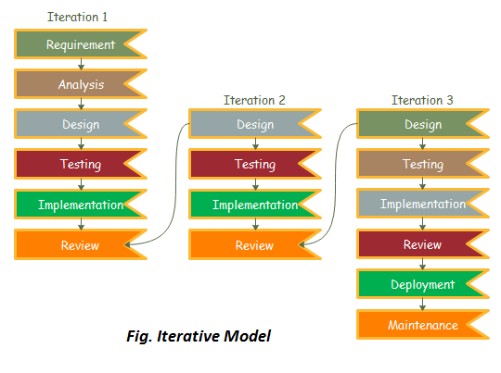

Slide 61
The various phases of Iterative model
Requirement gathering & analysis: In this phase, requirements are gathered from customers and check by an analyst whether requirements will fulfil or not. Analyst checks that need will achieve within budget or not. After all of this, the software team skips to the next phase.
Design: In the design phase, team design the software by the different diagrams like Data Flow diagram, activity diagram, class diagram, state transition diagram, etc.
Implementation: In the implementation, requirements are written in the coding language and transformed into computer programmes which are called Software.
Testing: After completing the coding phase, software testing starts using different test methods. There are many test methods, but the most common are white box, black box, and grey box test methods.

Slide 62
When to use the Iterative Model?
When requirements are defined clearly and easy to understand.
When the software application is large.
When there is a requirement of changes in future.

Slide 63
Advantage of Iterative Model
Testing and debugging during smaller iteration is easy.
It is easily acceptable to ever-changing needs of the project.
Risks are identified and resolved during iteration.
Limited time spent on documentation and extra time on designing.

Slide 64
Disadvantage of Iterative Model
It is not suitable for smaller projects.
More Resources may be required.
Design can be changed again and again because of imperfect requirements.
Requirement changes can cause over budget.
Project completion date not confirmed because of changing requirements.

Slide 65
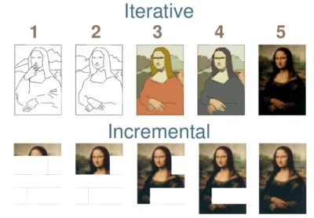

Slide 66
Spiral Model
The spiral model is a combination of increment and iterative models and in this, we focused on risk handling along with developing the project with the incremental and iterative approach, producing the output quickly as well as it is good for big projects.
The software is created through multiple iterations using a spiral approach.
Later on, after successive development the final product will develop, and the customer interaction is there so the chances of error get reduced.

Slide 67
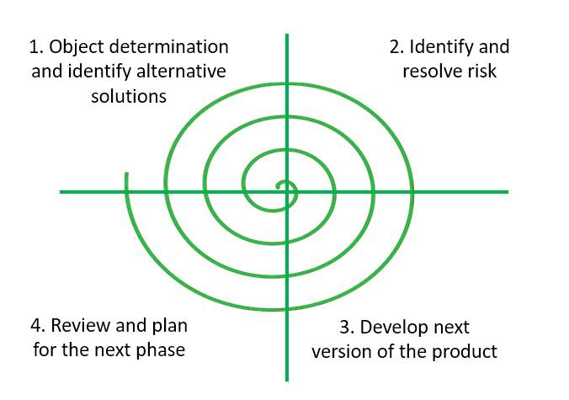
Objectives determination and identify alternative solutions: Requirements are gathered from the customers and the objectives are identified, elaborated, and analyzed at the start of every phase. Then alternative solutions possible for the phase are proposed in this quadrant.
Identify and resolve Risks: During the second quadrant, all the possible solutions are evaluated to select the best possible solution. Then the risks associated with that solution are identified and the risks are resolved using the best possible strategy. At the end of this quadrant, the Prototype is built for the best possible solution.
Develop the next version of the Product: Identified features are developed and verified through testing.
Review and plan for the next Phase: The Customers evaluate the so-far developed version of the software. In the end, planning for the next phase is started.

Slide 68
When to use Spiral Model?
When the project is large
When requirements are unclear and complex
When changes may require at any time
Large and high budget projects

Slide 69
Advantages
High amount of risk analysis
Useful for large and mission-critical projects.
Disadvantages
Can be a costly model to use.
Risk analysis needed highly particular expertise
Doesn't work well for smaller projects.

Slide 70
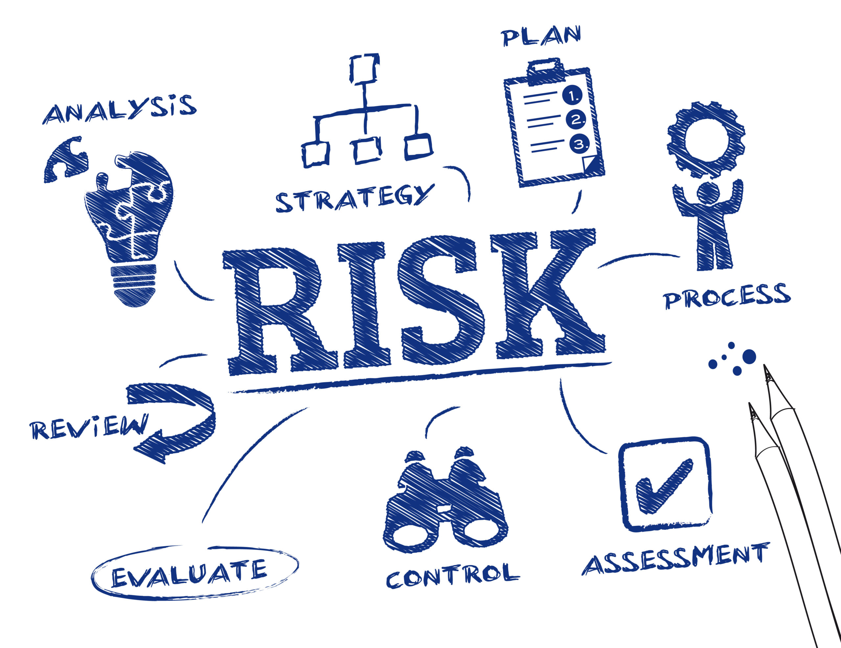

Slide 71
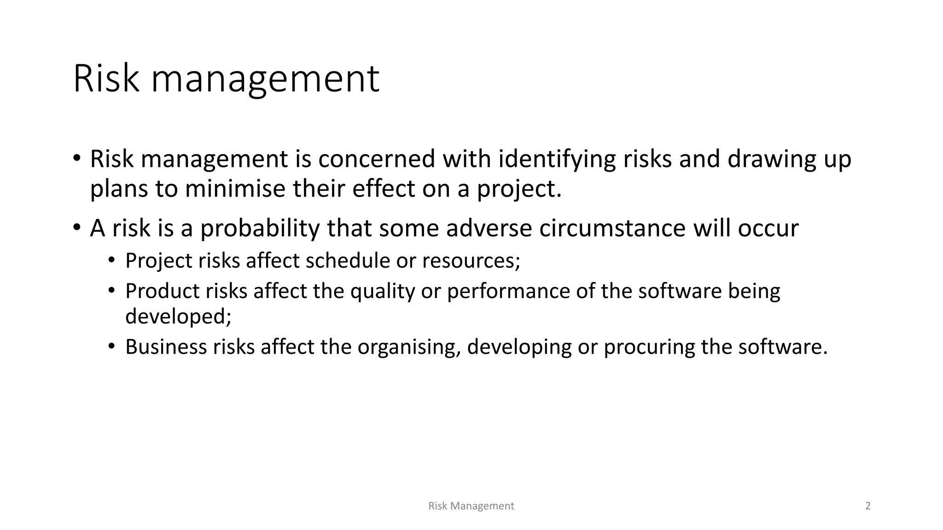

Slide 72
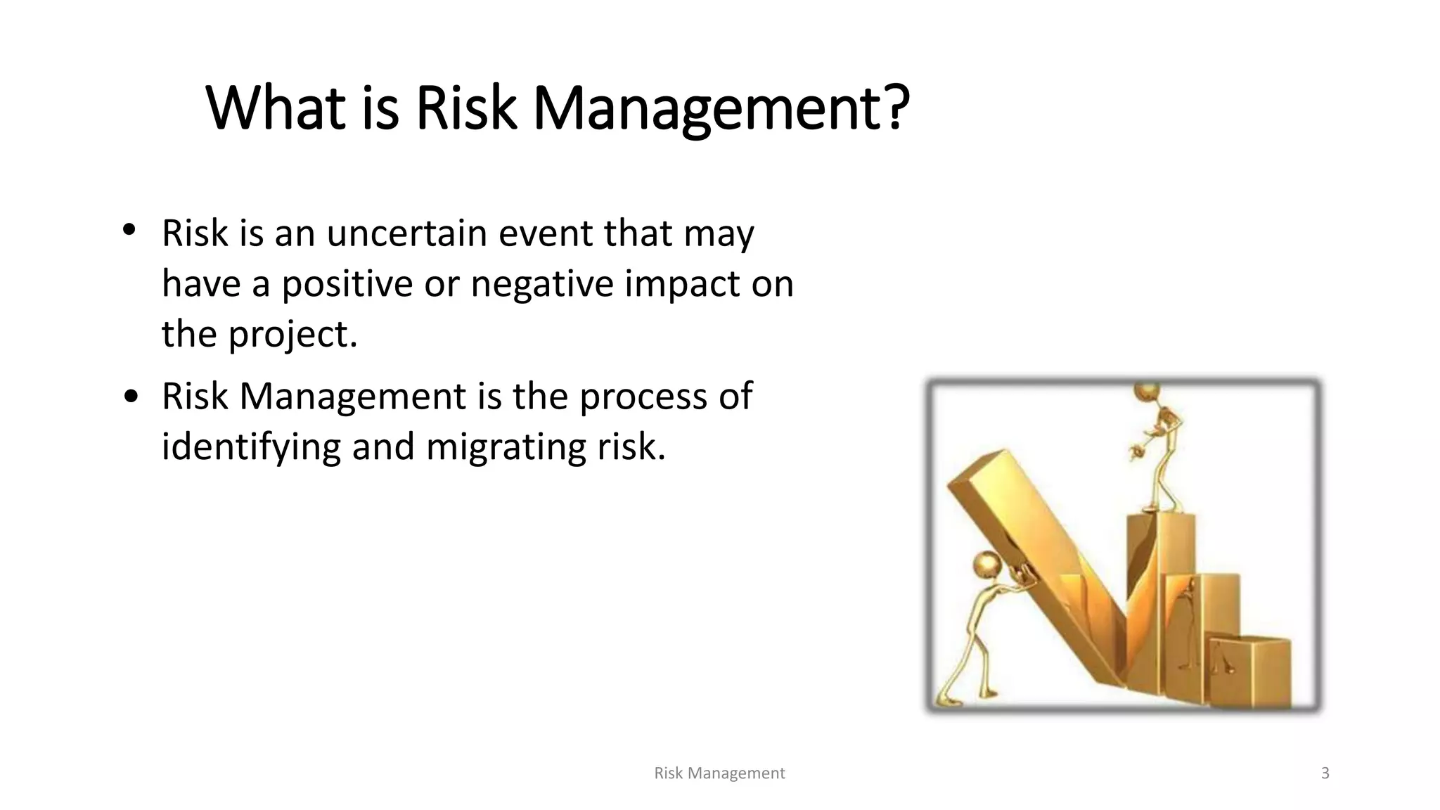

Slide 73
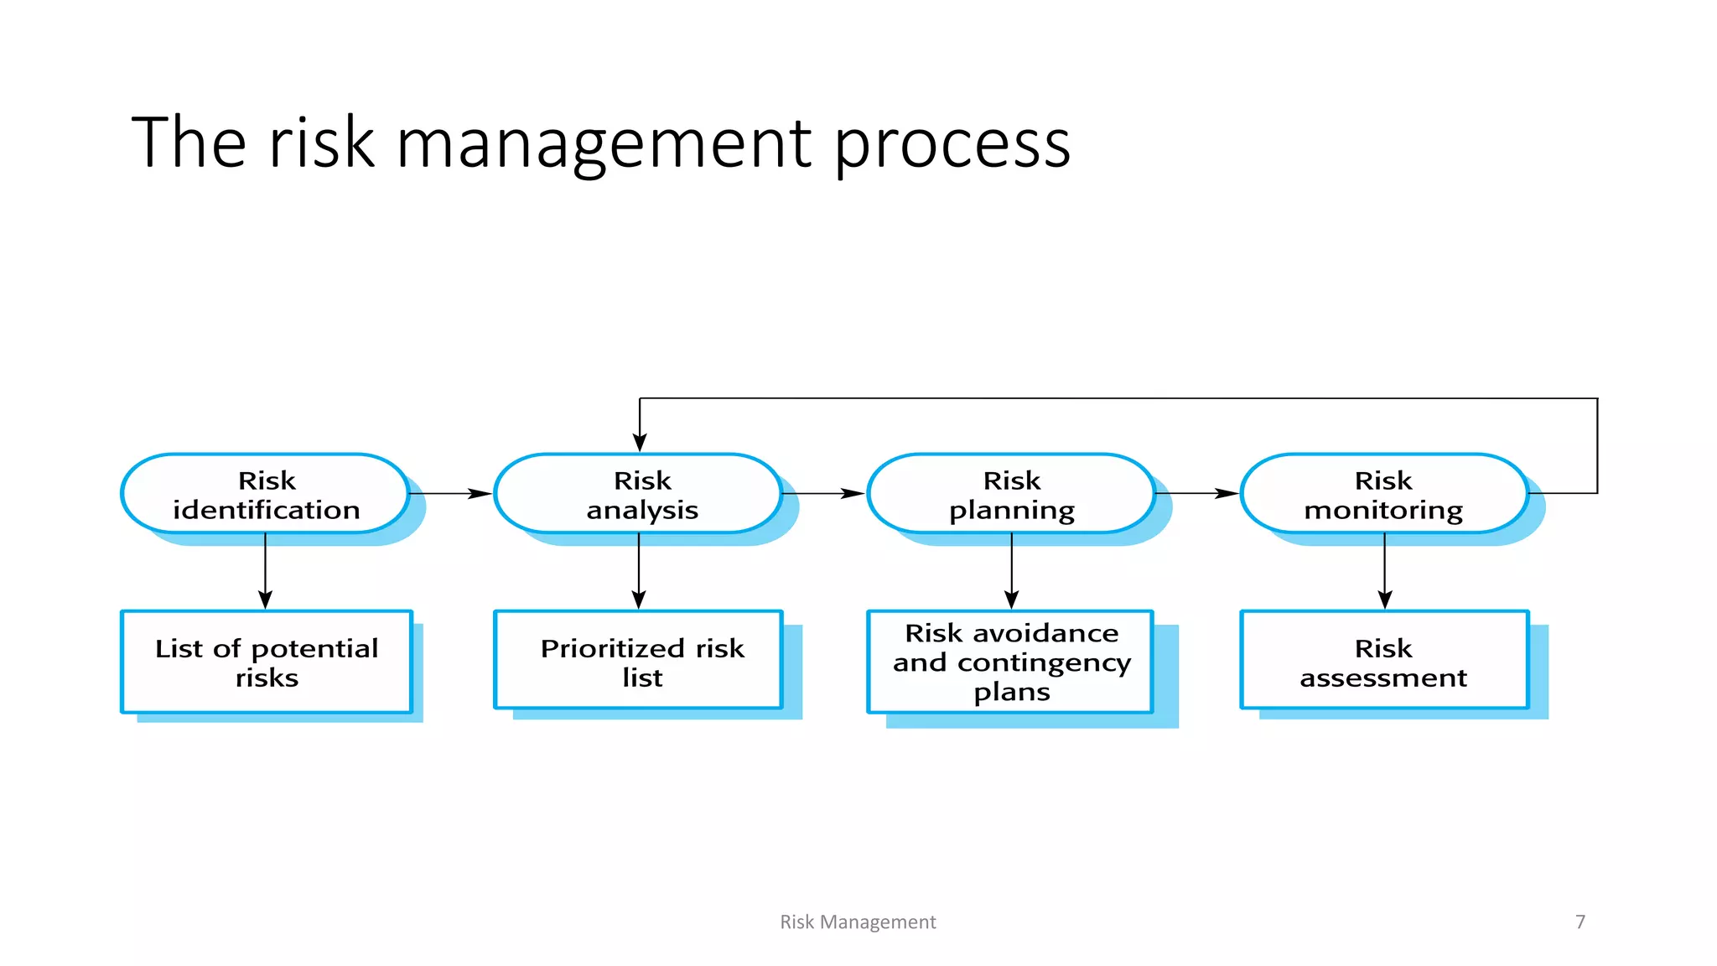

Slide 74
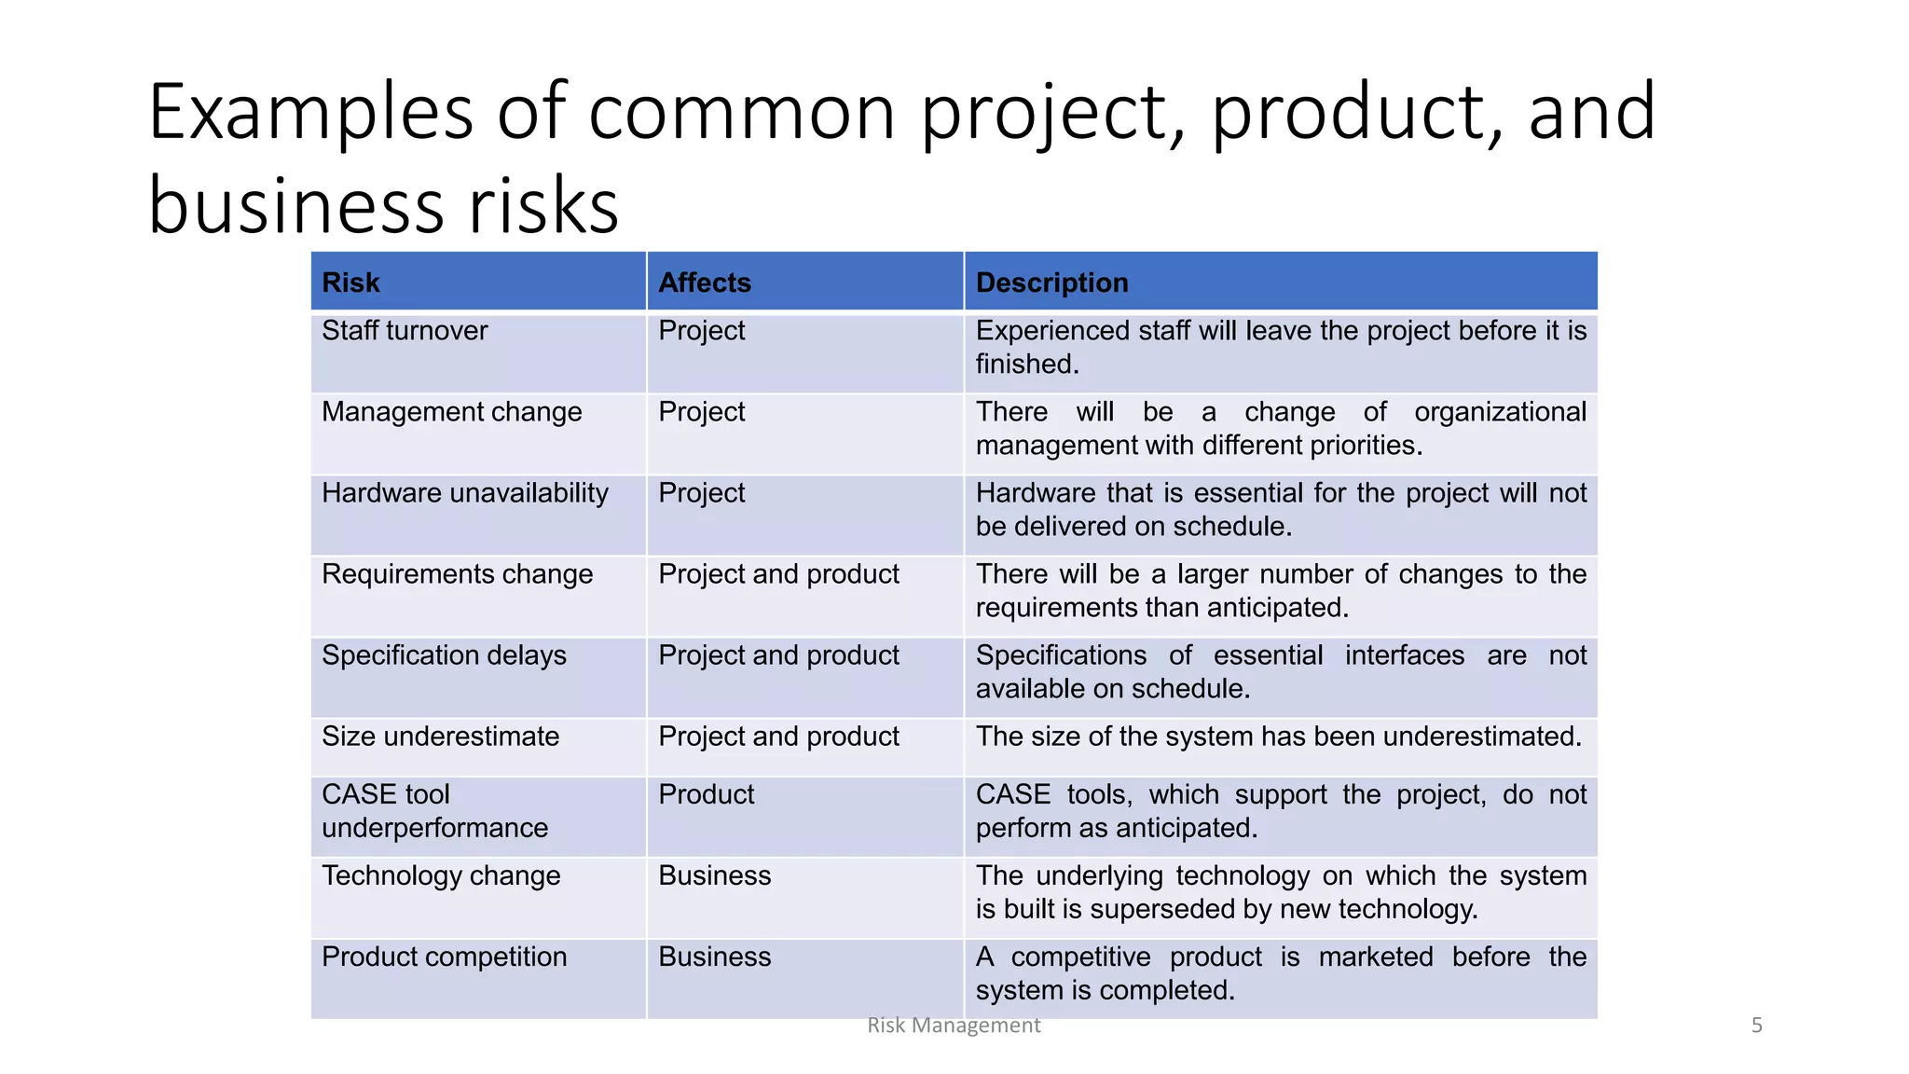

Slide 75
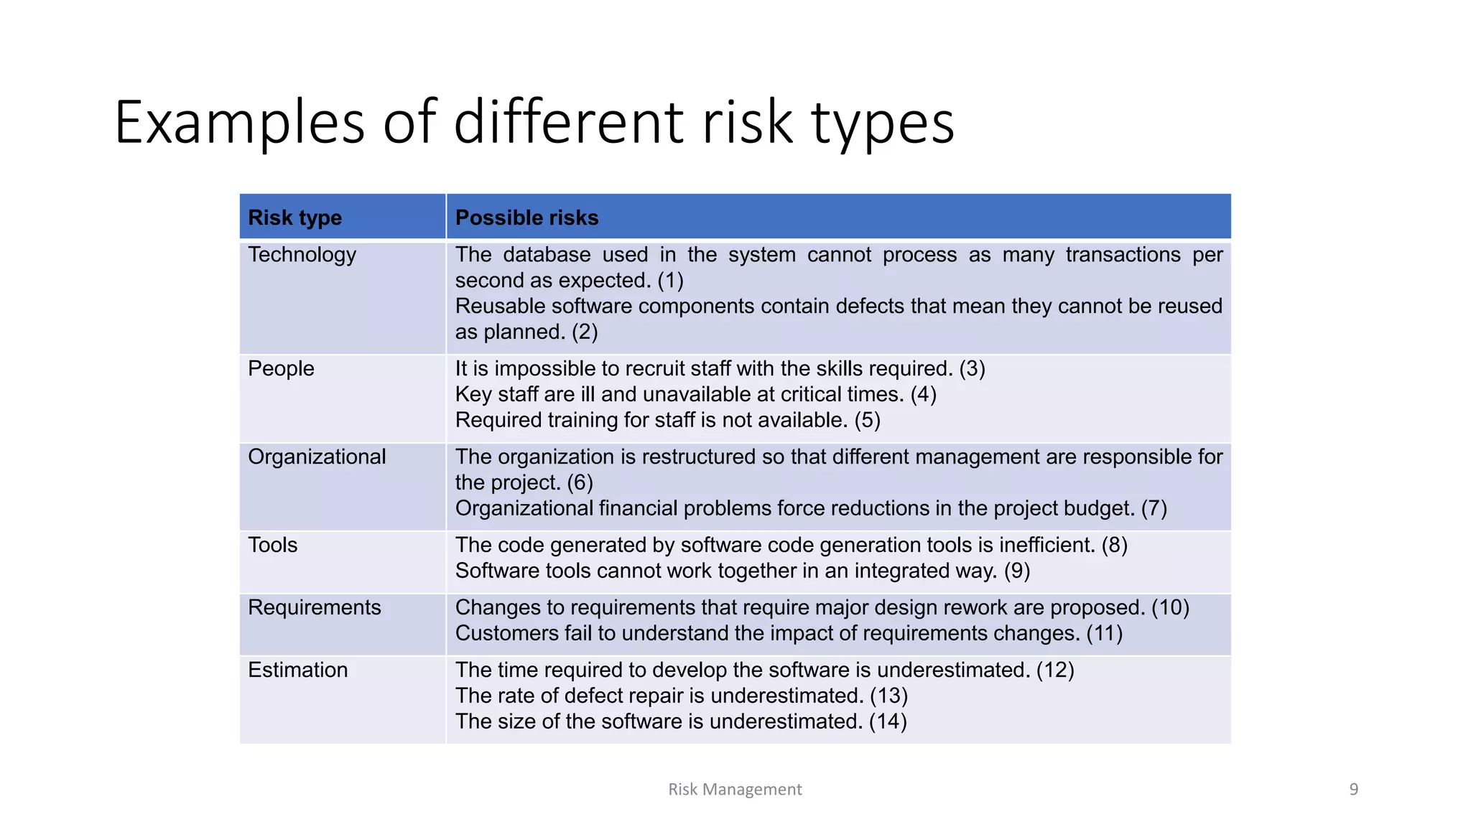

Slide 76
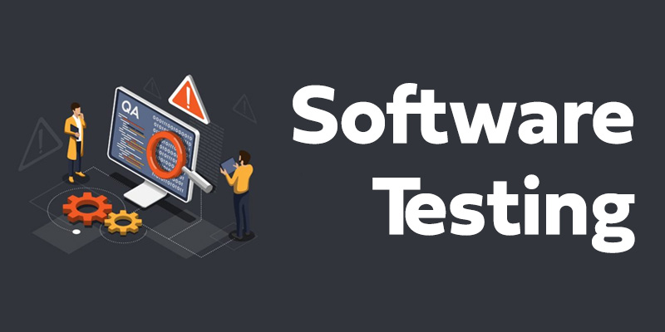

Slide 77
Software testing
Software testing can be stated as the process of verifying and validating whether a software or application is bug-free, meets the technical requirements as guided by its design and development, and meets the user requirements effectively and efficiently by handling all the exceptional and boundary cases.
Software testing can be divided into two steps:
Verification: It refers to the set of tasks that ensure that the software correctly implements a specific function. It means “Are we building the product right?”.
Validation: It refers to a different set of tasks that ensure that the software that has been built is traceable to customer requirements. It means “Are we building the right product?”.

Slide 78
Importance of Software Testing
Defects can be identified early: Software testing is important because if there are any bugs they can be identified early and can be fixed before the delivery of the software.
Improves quality of software: Software Testing uncovers the defects in the software, and fixing them improves the quality of the software.
Increased customer satisfaction: Software testing ensures reliability, security, and high performance which results in saving time, costs, and customer satisfaction.
Helps with scalability: Software testing type non-functional testing helps to identify the scalability issues and the point where an application might stop working.
Saves time and money: After the application is launched it will be very difficult to trace and resolve the issues, as performing this activity will incur more costs and time. Thus, it is better to conduct software testing at regular intervals during software development.

Slide 79
Need for Software Testing
Software bugs can cause potential monetary and human loss. There are many examples in history that clearly depicts that without the testing phase in software development lot of damage was incurred:
1985: Canada’s Therac-25 radiation therapy malfunctioned due to a software bug and resulted in lethal radiation doses to patients leaving 3 injured and 3 people dead.
1994: China Airlines Airbus A300 crashed due to a software bug killing 264 people.
1999: A software bug caused the failure of a $1.2 billion military satellite launch.
2015: A software bug in fighter plan F-35 resulted in making it unable to detect targets correctly.
2015: Bloomberg terminal in London crashed due to a software bug affecting 300,000 traders on the financial market and forcing the government to postpone the pound debt sale.
Starbucks was forced to close more than 60% of its outlet in the U.S. and Canada due to a software failure in its system.
Nissan cars were forced to recall 1 million cars from the market due to a software failure in the car’s airbag sensory detectors.

Slide 80
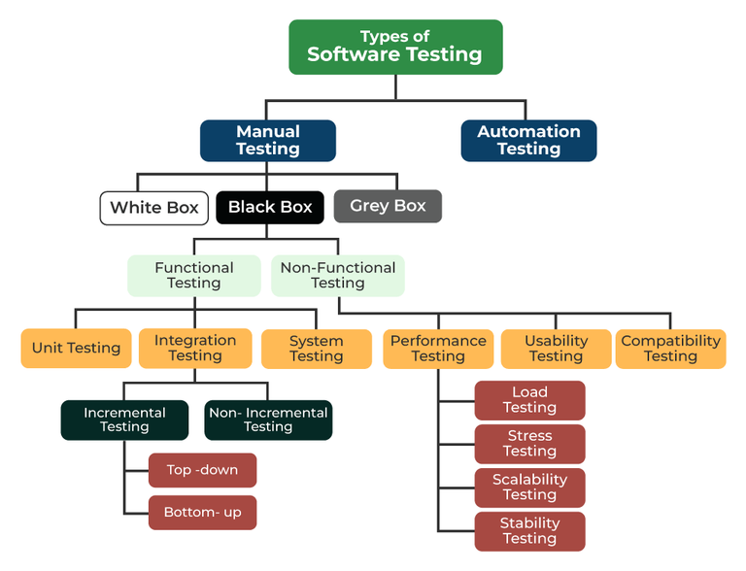

Slide 81
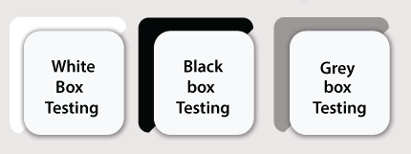
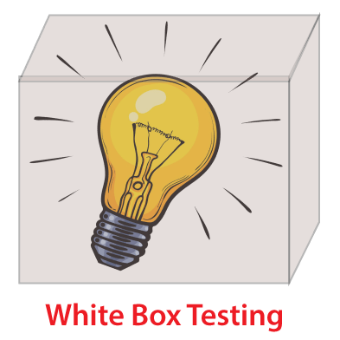
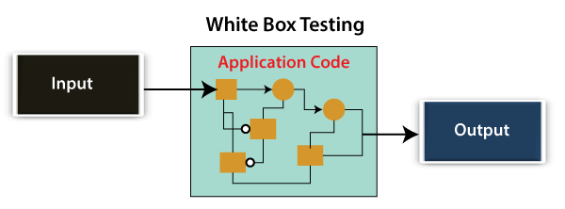
White Box Testing
In white-box testing, the developer will inspect every line of code before handing it over to the testing team or the concerned test engineers.

Slide 82

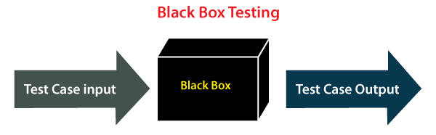
Black Box Testing
Another type of manual testing is black-box testing.
In this testing, the test engineer will analyze the software against requirements, identify the defects or bug, and sends it back to the development team.
Then, the developers will fix those defects, do one round of White box testing, and send it to the testing team.

Slide 83
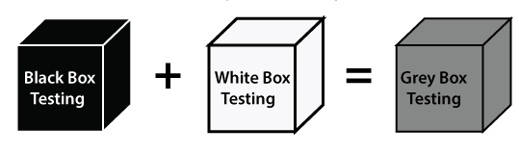
Grey Box Testing –
Another part of manual testing is Grey box testing.
It is a collaboration of black box and white box testing.
Since, the grey box testing includes access to internal coding for designing test cases.
Grey box testing is performed by a person who knows coding as well as testing.

Slide 84
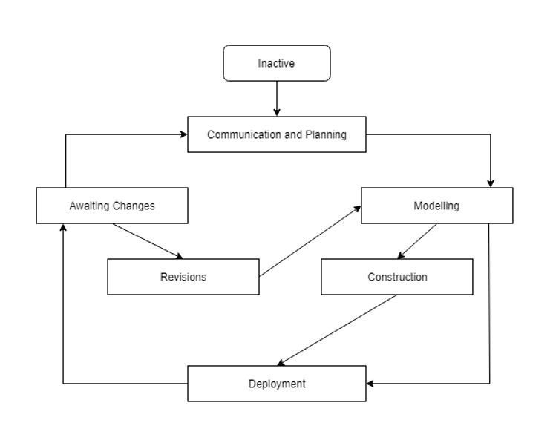
Concurrent development model
Concurrent development model is quite different from the incremental model.
The incremental model is performed sequentially while the concurrent development model is performed simultaneously.
Instead of having a linear process flow, development processed create a net-like workflow.

Slide 85
In the concurrent development model, each activity has a state and occurs concurrently.
Transitions take place when an activity is triggered to move to another state.
Therefore, concurrent development model can be defined as a series of activities, tasks, and associated states.

Slide 86
Advantages of Concurrent model:
1. High flexibility
2. New features and designs may be further added
3. Each component occurs simultaneously
Disadvantages of Concurrent model:
Require a good teamwork
Least-planned design
Frequent errors and miscommunication during a process may trigger disruption in other states

Slide 87
Software Myths in Software Engineering
Software Myths are beliefs that do not have any pure evidence.
Software myths may lead to many misunderstandings, unrealistic expectations, and poor decision-making in software development projects.
Some common software myths include:
The Myth of Perfect Software: Assuming that it's possible to create bug-free software. In Reality, software is inherently complex, and it's challenging to eliminate all defects.
The Myth of Short Development Times: Assuming that software can be developed quickly without proper planning, design, and testing. In Reality, rushing the development process can lead to poor software and missed deadlines.
The Myth of No Maintenance: It is thought that software development is complete once the initial version is released. But in reality, the software requires maintenance and updates to remain functional and secure.

Slide 88
Software Myths in Software Engineering
The Myth of Cost Predictability: It is thought that the cost of the software can be easily predicted, but in reality, many factors can influence project costs, and estimates are often subject to change. There are many hidden costs available.
The Myth of Endless Features: It is believed that adding more features to software will make it better. But in reality, adding more features to the software can make it complex and harder to use and maintain. It may often lead to a worse user experience.
The Myth of No Testing Needed: It is assumed that there is no need to test the software if the coder is skilled or the code looks good. But in reality, thorough testing is essential to catch hidden defects and ensure software reliability.
Zero-Risk Software: It is assumed that it's possible to develop software with absolutely no risks. But in reality, all software projects involve some level of risk, and risk management is a critical part of software development.

Slide 89
How to Avoid Software Myths
Here are some steps you can take to avoid falling victim to common software myths:
Stay Informed: Keep up to date with the latest trends, practices, and developments in the field of software engineering.
Continuous Learning: Invest in ongoing education and professional development. Software engineering is an evolving field, and staying current is essential.
Data-Driven Decision-Making: Make decisions based on data, evidence, and real-world experiences rather than relying on common misconceptions.
Testing and Validation: Don't rely solely on assumptions. Test your software, gather data, and validate your ideas to confirm their accuracy.
Educate Team Members: Ensure that everyone on your development team is aware of common software myths and is committed to avoiding them.
Risk Assessment: When dealing with software development decisions, conduct risk assessments to identify potential pitfalls and myths that might affect the project.

Slide 90
Revision

Slide 91
Nature of Software
Software is:
Instructions (computer programs) that to executed provide desired features, function, and performance.
Data structures that enable the programs to adequately manipulate information, and
Document that describes the operation and use of the programs.
Characteristics of software:
Reliability: The ability of the software to consistently perform its intended tasks without unexpected failures or errors.
Usability: How easily and effectively users can interact with and navigate through the software.
Efficiency: The optimal utilization of system resources to perform tasks on time.
Maintainability: How easily and cost-effectively software can be modified, updated, or extended.
Portability: The ability of software to run on different platforms or environments without requiring significant modifications.

Slide 92
What is Software Engineering?
Software + Engineering
The software is a collection of integrated programs.
Software subsists of carefully-organized instructions and code written by developers on any of various particular computer languages.
Computer programs and related documentation such as requirements, design models and user manuals.
Engineering is the application of scientific and practical knowledge to invent, design, build, maintain, and improve frameworks, processes, etc.

Slide 94
Software Process
The term software specifies to the set of computer programs, procedures and associated documents (Flowcharts, manuals, etc.) that describe the program and how they are to be used.
A software process is the set of activities and associated outcome that produce a software product.
Software engineers mostly carry out these activities.

Slide 95
Software Crisis
Size: Software is becoming more expensive and more complex with the growing complexity and expectation out of software. For example, the code in the consumer product is doubling every couple of years.
Quality: Many software products have poor quality, i.e., the software products defects after putting into use due to ineffective testing technique. For example, Software testing typically finds 25 errors per 1000 lines of code.
Cost: Software development is costly i.e. in terms of time taken to develop and the money involved. For example, Development of the Advanced Automation System cost over $700 per lines of code.
Delayed Delivery: Serious schedule overruns are common. Very often the software takes longer than the estimated time to develop, which in turn leads to cost shooting up. For example, one in four large-scale development projects is never completed.

Slide 96
Program vs. Software
Software is more than programs. Any program is a subset of software, and it becomes software only if documentation & operating procedures manuals are prepared.
There are three components of the software as shown in fig:

Slide 97
Verification vs Validation

Slide 98
Process Flow
• Process Flow shows how the framework activities and the actions and the tasks that occur within each activity are organized with respect to sequence and time.
Types of process flows in SDLC
1. Linear Process Flow
2. Iterative Process Flow
3. Evolutionary Process Flow
4. Parallel Process Flow

Slide 99
Software Development Life Cycle (SDLC)

Slide 101
Requirement Engineering Process
It is a four-step process, which includes –
Feasibility Study
Requirement Elicitation and Analysis
Software Requirement Specification
Software Requirement Validation

Slide 102
Software Requirements
Functional Requirements:
Functional requirements define a function that a system or system element must be qualified to perform and must be documented in different forms.
The functional requirements are describing the behavior of the system as it correlates to the system's functionality.
Non-functional Requirements:
This can be the necessities that specify the criteria that can be used to decide the operation instead of specific behaviors of the system.
Non-functional requirements are divided into two main categories:
Execution qualities like security and usability, which are observable at run time.
Evolution qualities like testability, maintainability, extensibility, and scalability that embodied in the static structure of the software system.

Slide 104
Evolutionary Process Models
The evolutionary model is based on the concept of making an initial product and then evolving the software product over time with iterative and incremental approaches with proper feedback.
In this type of model, the product will go through several iterations and come up when the final product is built through multiple iterations.
Types of Evolutionary Process Models
Incremental Model
Iterative Model
Spiral Model

Slide 108
Objectives determination and identify alternative solutions: Requirements are gathered from the customers and the objectives are identified, elaborated, and analyzed at the start of every phase. Then alternative solutions possible for the phase are proposed in this quadrant.
Identify and resolve Risks: During the second quadrant, all the possible solutions are evaluated to select the best possible solution. Then the risks associated with that solution are identified and the risks are resolved using the best possible strategy. At the end of this quadrant, the Prototype is built for the best possible solution.
Develop the next version of the Product: Identified features are developed and verified through testing.
Review and plan for the next Phase: The Customers evaluate the so-far developed version of the software. In the end, planning for the next phase is started.

